Slide 1
Hackathon’25 : Solve Rubik’s Cube

Slide 2
An Efficient Implementation of Kociemba's Two-Phase Algorithm
Name: Ritam Pal
GitHub: RitamPal26
College: SRM IST, KTR
Email: ritamjunior26@gmail.com

Slide 3
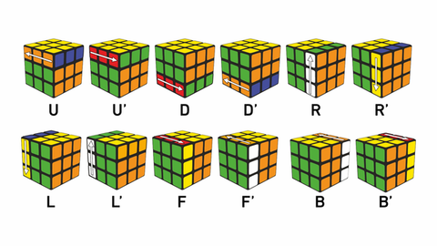
Breaking Down the Cube
The Challenge: Solving a state space of ~4.3 quintillion possibilities. A direct brute-force search is impossible.
Our Problem-Solving Approach: Divide and Conquer.
We use Kociemba's Two-Phase Algorithm to break the problem into two smaller, manageable steps.
Phase 1: Reach an intermediate group of states (G1) where pieces are oriented correctly.
Phase 2: Solve the cube from G1 using a restricted set of moves.

Slide 4
Representing the Cube Digitally
How we model the cube (Cube.cpp):
The cube's state is not stored as a visual 3D array.
Instead, we use coordinate-based arrays to track the position and orientation of the 8 corners and 12 edges.
Why this structure is efficient:
It allows for rapid calculation of state changes.
It's the ideal representation for the mathematical operations required by the solving algorithm.
This forms the core of our Move Engine, enabling fast state prediction after each rotation.

Slide 5
Phase 1: Finding the G1 Subgroup
Goal: Correctly orient all corners and edges.
Method: We use an Iterative Deepening A* (IDA*) search, implemented in IDASolver.cpp.
The Heuristic "Brain" (Phase1Heuristic.cpp):
To make the search smart, we use Pattern Databases (PDBs).
These are pre-calculated lookup tables that give a very accurate estimate of the minimum moves needed to orient the pieces.
This allows the IDA* algorithm to prune billions of bad paths and find a solution quickly.

Slide 6
Phase 2: The Final Solution
Goal: With orientations solved, we now arrange the pieces into their final positions.
Method: A second IDA* search using a restricted move set (U, D, R2, L2, F2, B2) that keeps the cube inside the G1 group.
The Heuristic "Brain" (Phase2Heuristic.cpp):
We use a new set of PDBs designed specifically for Phase 2.
These heuristics estimate the moves needed to solve the permutation of corners and edges.

Slide 7
Algorithm Efficiency
Speed: Finds near-optimal solutions (averaging 20-21 moves) from any scramble, typically in under one second.
Time Complexity: While difficult to state formally, the heuristic pruning of IDA* makes it vastly superior to brute-force methods.
Space Complexity: The main memory cost is the size of the Pattern Databases.
Our PDBs are generated offline by PatternDatabase.cpp and stored in corner_pdb.dat (~336 MB). This is a one-time cost for lightning-fast lookups during solving.

Slide 8
Conclusion & Bonus Areas
Summary: We successfully implemented an efficient, two-phase Rubik's Cube solver that meets all core design challenges.
Creativity in Design (main.cpp): The program provides a clear, human-readable, step-by-step solution path for any given scramble.
Future Scope (Bonus Areas):
Visual Simulation: The current move engine can be hooked into a simple UI (like OpenGL or SFML) to create a "Wow Factor" visual of the cube being solved.
Scalability: The design principles (IDA*, heuristics) can be extended to solve larger cubes like the 4x4, though this requires designing new coordinate systems and PDBs.

